Slide 1
College Signaling to Students: Mission Statements categorized by college types and student enrollments
Jennifer Bochenek

Slide 2
Outline
Mission Statements
Diversity in the context of colleges/universities
Women attending college
Women earning STEM degrees
Results of this research

Slide 3
Mission Statements
A mission statement is an approved statement of a institution’s goals, values, purpose, and/or plan.
“Northeast Community College is dedicated to the success of students and the region it serves.”
“Eastern Michigan University is committed to excellence in teaching through traditional and innovative approaches the extension of knowledge through basic and applied research and creative and artistic expression. Building on a proud tradition of national leadership in the preparation of teachers we maximize educational opportunities and personal and professional growth for students from diverse backgrounds through an array of baccalaureate master's and doctoral programs. We strive to provide a student-focused learning environment that enhances the lives of students and positively impacts the community. We extend our commitment beyond the campus boundaries to the wider community through service initiatives and public and private partnerships of mutual interest addressing local regional national and international opportunities and challenges.”
Notes:
Mission statements are required for accreditation.

Slide 4
Mission Statements
Are they empty words?
“…mission statements may reflect, rather than drive, the realities of these institutions' environments. These environments include the desires of their students and alumni (and taxpayers). ..” (Morphew & Hartley, 2006)
Target populations
Mission statements often mention target populations, or a particular group of students. Taylor and Morphew (2010) found that college with histories of service to students of particular backgrounds often claim to serve those populations.
For example traditionally Hispanic-Serving Institutions (HSIs) or Historically Black Colleges and Universities (HBCUs) are likely to mention their background.
This is all part of the signaling process to students, so theoretically we can expect there to be mention of
Notes:
Brief history of Mission Statements – e.g. how they came into use as required by accreditation agencies.

Slide 5
Mission Statements & Diversity
Urciuoli (2003) notes that diversity (as a term) became more used in the 1990s as a less-threatening alternative to ‘multiculturalism’.
Multiculturism was a term that meant a full citizenship of members of racial/ethnic minorities.
Diversity was used in a more vague way, enough to be open to interpretation by the reader.
Diversity began to be used more often referring to something other than racial diversity.

Slide 6
Diversity
Types of diversity:
Geography
States
Nations
Racial/Ethnic
Gender and/or Gender Identity
Age and/or Generation
Religious and Spiritual beliefs
Disability and Ability
Socioeconomic Status and background
Sexual Orientations

Slide 7
Gender Diversity in College
The number of women in college has increased dramatically in the past 60 years:
In 1957, 34.7% of students were women.
In 2015, 57.0% of students were women.
In 2016, women were more likely to finish a degree within 6 years
62.5% of women who started college in 2010 graduated vs
56.6% of males
(U.S. DoE, 2018)
Notes:
Graduation rates are within the same college as they started at (does not include transfers)

Slide 8
Gender Diversity in STEM fields
While women earn 58% of bachelor’s degrees but only 35.1% of STEM degrees (U.S. DoE, 2018).
Percentage of Degrees Earned by Women in Postsecondary Institutions (2014–2015)
 | Bachelor’s | Master’s | PhD
Biological and biomedical sciences | 59.00% | 57.30% | 53.30%
Mathematics and statistics | 43.00% | 40.60% | 27.90%
Physical sciences and science technologies | 38.50% | 37.50% | 34.30%
Engineering and engineering technologies | 18.70% | 25.20% | 23.20%
Computer and information sciences and support services | 18.00% | 30.40% | 22.50%
All STEM fields | 35.10% | 32.70% | 34.40%

Slide 9
This study
Examining college mission statements in the context of their student body.
2620 Mission Statements collected
By Carnegie classification
523 Associate colleges
347 Bachelors colleges
279 Masters colleges
153 Doctoral colleges
527 N/A, 13 Law, 112 Theological, 39 Arts, 11 Tribal
Only Bachelors, Masters, and Doctoral colleges used for this sample (N = 779)
Data source:
The Integrated Postsecondary Education Data System (IPEDS)

Slide 10
Demographics
 | This Study | Population
% Women Enrollment | 59.0% | 57.0%
% STEM Degrees earned by Women | 46.2% | 35.1%
% of Women grad who earn STEM Degrees | 6.7% | 7.9%
When comparing the average number of Women enrolled at the schools in this sample to the population they are comparable
However, the percent of STEM degrees awarded to Women in this sample is higher than the general population. This could be due to the exclusion of all but Bachelor, Masters, and Doctoral Colleges and Universities.
Another way to measure STEM degrees is by looking at the percent of Women who graduate with STEM, rather than the percent of STEM graduates who are Women. This value is much lower as some colleges don’t have STEM programs.
Notes:
% of men grad who earn STEM Degrees is 11.3% pop and 11.1% sample

Slide 11
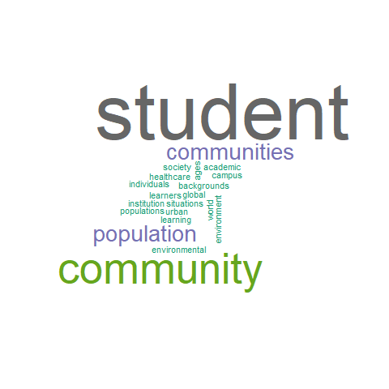
Mission Statements: Words after diversity
Word after “Diverse” | n
student | 11
community | 6
communities | 3
population | 3
academic | 1
ages | 1
backgrounds | 1
campus | 1
environment | 1
environmental | 1
global | 1
healthcare | 1
individuals | 1
institution | 1
learners | 1
learning | 1
populations | 1
situations | 1
society | 1
urban | 1
world | 1

Slide 12
Mission Statements: A Summary

Slide 13
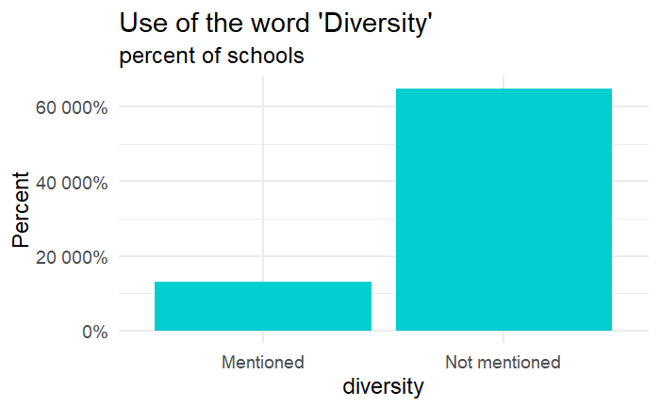
STEM Degrees and Women
When looking at schools that mentioned ‘Diversity’ in their mission statements, there was no effective difference in the percentage of women students graduating with STEM degrees.
“Diversity” | Mean | n
Mentioned | 45.6% | 132
Not mentioned | 46.4% | 647

Slide 14
Results by Quartiles
The quartiles show that there is a strong skew to the left.
Meaning, in this case, that roughly 75% of schools have a less Women in STEM graduation rate of less than 50%.
Initial analyses looked at the differences between Q1 and Q4
Future analyses could look at Q1 and Q2 vs Q3 and Q4.
Quartile | % STEM Women
Q1 | 0% - 21.9%
Q2 | 22.0% - 37.9%
Q3 | 38.0% - 51.9%
Q4 | 52.0% - 100%

Slide 15
Log Odds Ratios

Slide 16
Plot of nearness (Q1 vs Q4)

Slide 17
Future Directions
I would like to expand the key words used:
Right now Diversity/Diverse/Diverseness was used, but what about the terms conceptually similar?
E.g., mentions of specific kinds of diversity without actually using the word.
I would like to expand the number of mission statements collected:
I currently have direct location html links to mission statement pages for an additional 3697 colleges/universities.
I would like to expand the groups analyzed:
For now I’ve looked at Women in STEM, but what about other minorities in higher education?

Slide 18
Questions?

Slide 19
References
Morphew, C. C. & Hartley, M. (2006). Mission Statements: A Thematic Analysis of Rhetoric Across Institutional Type. The Journal of Higher Education 77(3), 456-471. The Ohio State University Press. Retrieved May 26, 2019, from Project MUSE database.
Taylor, B. J., & Morphew, C. C. (2010). An analysis of baccalaureate college mission statements. Research in Higher Education, 51(5), 483-503.
Urciuoli, B. (2003). Excellence, leadership, skills, diversity: Marketing liberal arts education. Language & Communication, 23(3–4), 385–408.
U.S. Department of Education, National Center for Education Statistics. (2018). Digest of Education Statistics, 2016 (NCES 2017-094)
Ginder, S.A., Kelly-Reid, J.E., and Mann, F.B. (2018). Postsecondary Institutions and Cost of Attendance in 2017– 18; Degrees and Other Awards Conferred, 2016–17; and 12-Month Enrollment, 2016–17: First Look (Provisional Data) (NCES 2018-060rev). U.S. Department of Education. Washington, DC: National Center for Education Statistics. Retrieved [date] from http://nces.ed.gov/pubsearch.

